Slide 1
SOHO UVCS CMEs
John O'Neill
Dr. Chris St. Cyr
Dr. Leila Mays
August 4, 2010

Slide 2
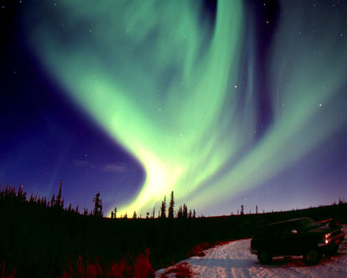
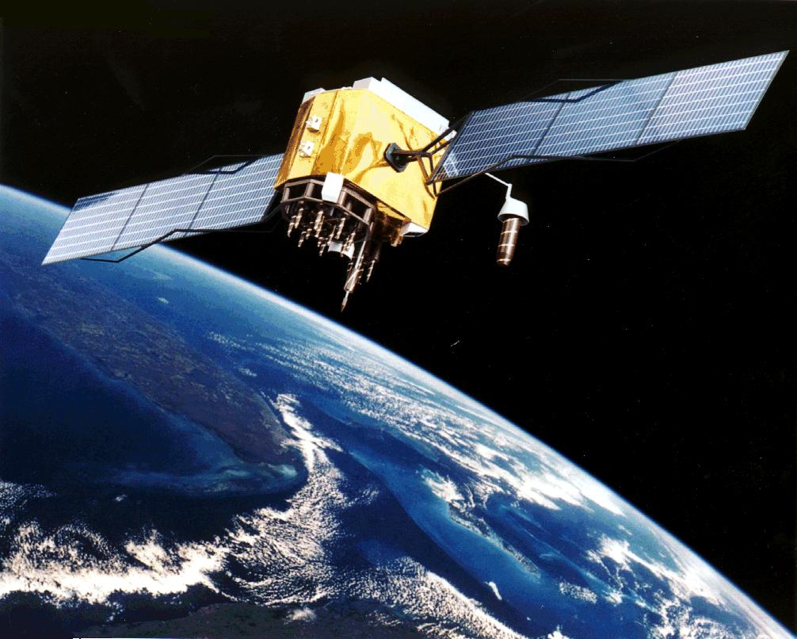
Why Are Coronal Mass Ejections Studied
  CMEs can pose dangerous in several ways:
      Disrupt satellites in orbit
      Expose astronauts to high energy radiation
      Creates geomagnetic storms
      Damage equipment on Earth sensitive to induced currents.

Slide 3
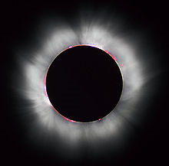
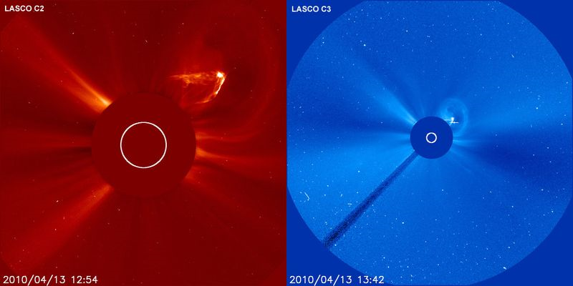
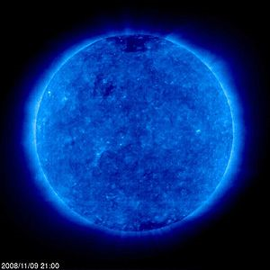
How Are CMEs Studied
Until the 1970's, the only way to study the sun's corona was during a solar eclipse.
We can now create an artificial eclipse using a coronal spectrograph

Slide 4
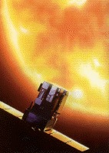
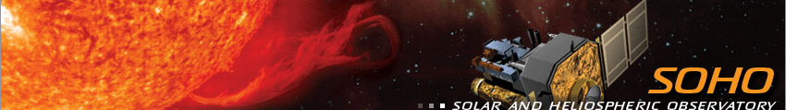
The SOHO Satellite
The Solar and Heliospheric Observatory was launch in December 1995. Originally planned for a two year mission, SOHO continues to operate today.
There are twelve instruments contained within the satellite. Data from three of these was predominately used for this summer research: EIT, LASCO, and UVCS.

Slide 5
Ultimate Goals
  Gain a greater understanding of solar dynamics
  Predict eruptions based on the sun's state
  Study the composition and characteristics of CMEs as the leave the sun and travel into the interplanetary medium

Slide 6
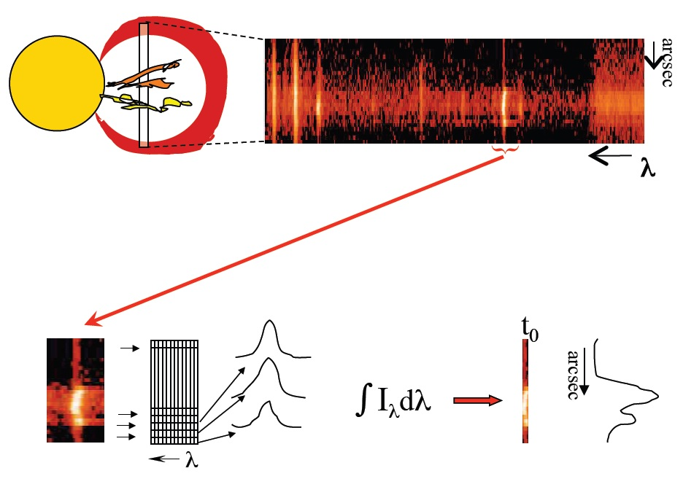
Ultimate Goals

Slide 7
SOHO Data
There are greater than 10,000 CMEs as detected by LASCO from 1996-2005.
During that time UVCS viewed 839 of these events through its spectrometer.
The UVCS events created the base subset with which to work.

Slide 8
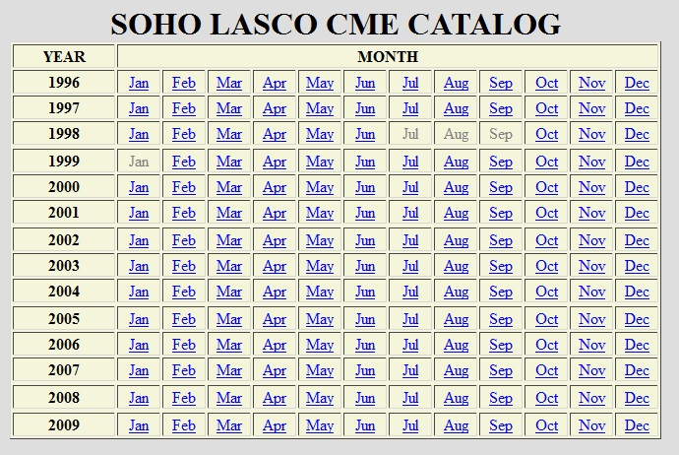
Data Archive
Publicly available catalog of CMEs.
Contains every ejection detected by LASCO over a fourteen year span.

Slide 9
Putting It All Together
There are three catalogs with identified locations of corresponding solar flares.
      Metric Type II list compiled from ground based observations, Dr. Gopalswamy, 154 events
      Dr. Yashiro list identified for 2006 paper in The Astrophysics Journal, 887 events
      The Wind/WAVES type II burst catalog, Dr. Gopalswamy, 327 events
Ultimately I was able to create a database of 185 of UVCS detected CMEs with flare locations identified.

Slide 10
Final Data Subset

Slide 11
Final Data Subset

Slide 12
Final Data Subset

